Slide 1
Confirmation
Review

Slide 2
The Bible
God’s Relationship to Man
Man’s Relationship with God
Based upon Covenants

Slide 3
The Bible
The Old Testament
(The Ancient People of Israel)
(The Apocrypha)
The New Testament
(The Life of Jesus and Early Church)

Slide 4
The Old Testament
Pentateuch (Torah)
Genesis, Exodus, Leviticus, Numbers, Deuteronomy
Historic Books
Joshua, Judges, Ruth, 1&2 Samuel, 1&2 Kings,
1&2 Chronicles, Ezra, Nehemiah, Esther
Poetry/Wisdom
Job, Psalms, Proverbs, Ecclesiastes, Song of Songs
Prophets
Isaiah, Jeremiah, Lamentations, Ezekiel, Daniel, Hosea, Joel, Amos, Obadiah, Jonah, Micah, Nahum Habakkuk, Zephaniah, Haggai, Zechariah, Malachi

Slide 5
The Bible
Seven Covenants
Adamic Covenant
Noahic Covenant
Abrahamic Covenant
Palestinian Covenant
Mosaic Covenant
Davidic Covenant
New Covenant

Slide 6
Genesis
Pentateuch (Torah)
GENESIS (The Beginnings)
Creation Story
The Flood (Noah)
The Tower of Babel
The Patriarchs
Abraham
Isaac
Jacob (Israel)
Joseph

Slide 7
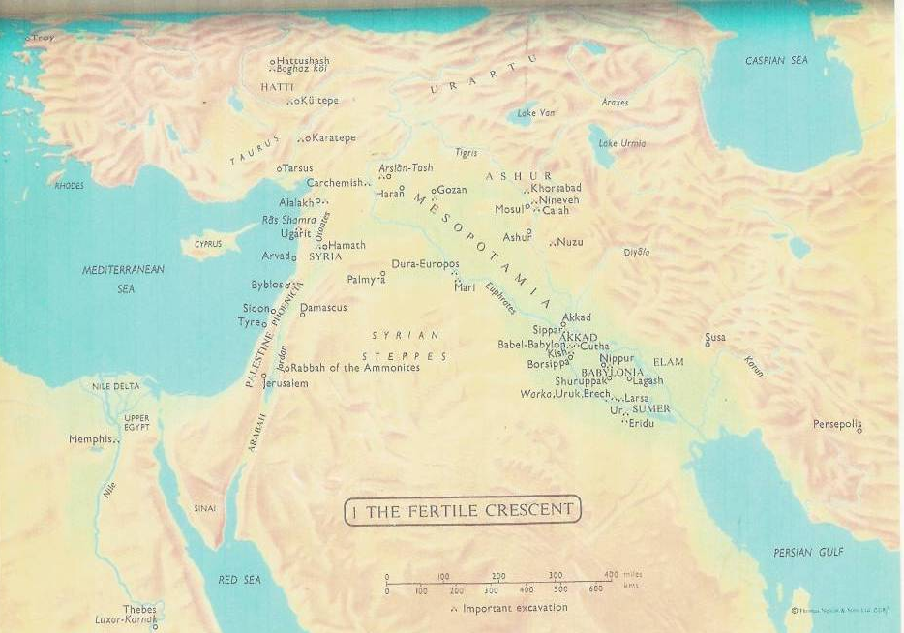
The Fertile Crescent

Slide 8
Hebrews Enslaved

Slide 9
Moses and the Law
Exodus
Early years of Moses to the Exodus and the Ten Commandment s and other Laws
Leviticus
Moses and Ritual Law
Numbers
Wilderness Travels & Governing Details
Deuteronomy
Conquering of Canaan & Moses Death

Slide 10
Moses & Aaron Before The Pharaoh

Slide 11
10th Plague – Death of all First Born

Slide 12
Moses Led His People To Freedom

Slide 13
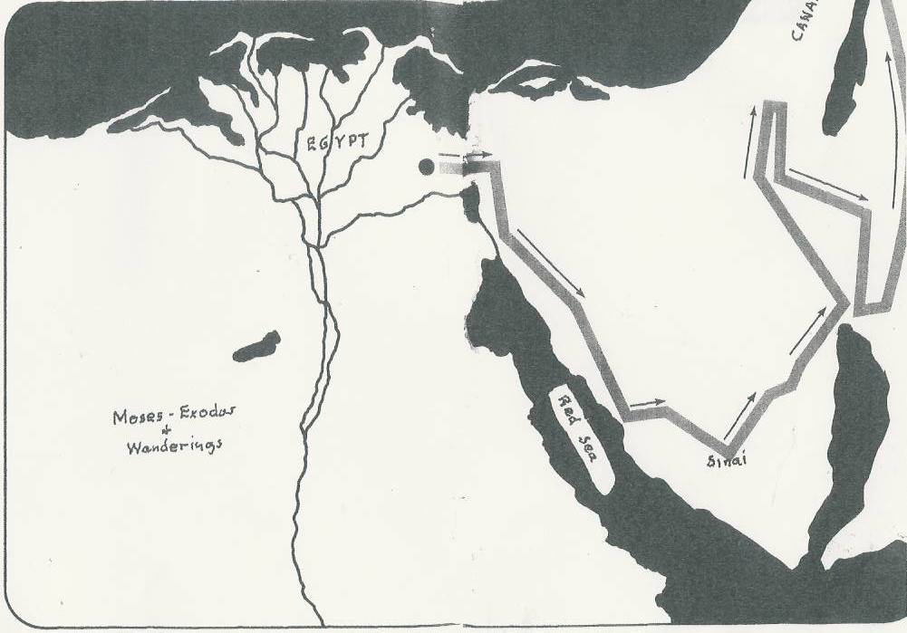
40 Years in the Wilderness

Slide 14
Moses and The Ten Commandments – Mt. Sinai

Slide 15
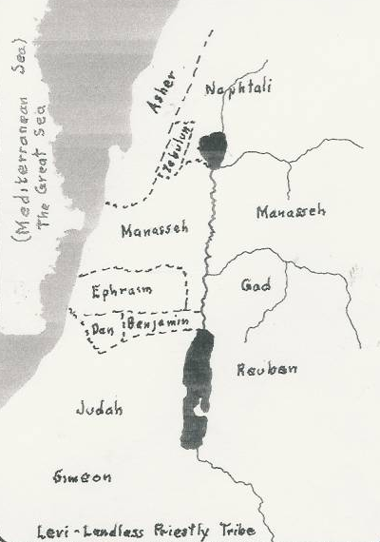
Hebrew Tribes

Slide 16
Judges
Not Judges As Of Today
Not Kings
~
Leaders Who Were
Respected and Followed -
Chosen By God

Slide 17
The United Kingdom of Israel 1030 - 931 BC
Enemy
The Philistines

Slide 18
King Saul 1030 – 1010 BC

Slide 19
The Reign of David 1008 – 970 BC
2 Samuel 5:1-5

Slide 20
David’s Kingdom

Slide 21
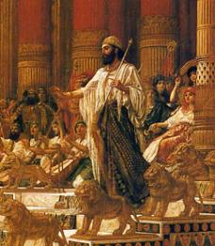
The Reign Of Solomon 970 -931 BC

Slide 22
The Temple In Jerusalem
960 BC – 586 BC

Slide 23
The Divided Kingdom 930 BC Northern Tribes Rebel

Slide 24
Northern Kingdom Of Israel (922 – 721 BC)
Conquered
By
Assyria
721 BC

Slide 25
The Southern Kingdom of Judah (922-587 BC)
Fell
To The
Babylonians
587 BC

Slide 26
The
Age
Of
The
Prophets

Slide 27
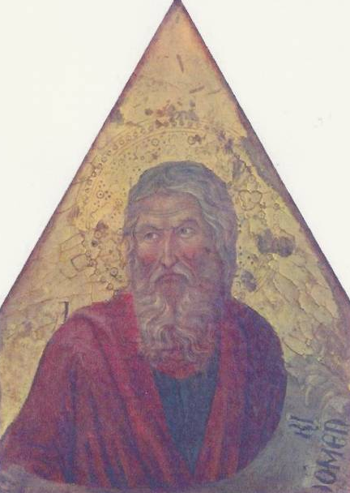
Major Prophets
Isaiah
Chapters 1-39
40- Before and After Exile

Slide 28
Major Prophets
Jeremiah & Lamentations
(1 & 2 Kings)

Slide 29
Major Prophets
Ezekiel

Slide 30
Major Prophets
Daniel

Slide 31
Minor Prophets
Hosea
Joel
Amos
Obadiah
Jonah
Micah
Nahum
Habakkuk
Zephaniah
Haggai
Zechariah
Malachi

Slide 32
Alexander The Great of Greece Conquers Palestine – 336 BC

Slide 33
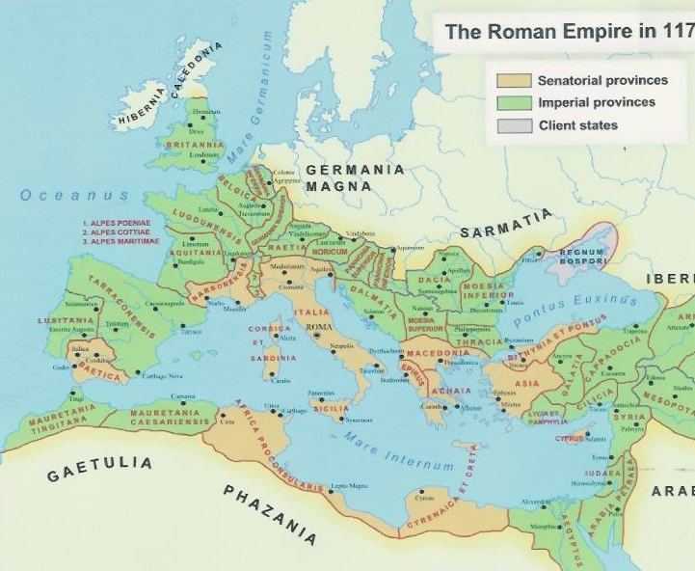
Roman Empire Conquered Palestine - 63 BC

Slide 34
The New Testament
The
New Covenant
Of
Jesus – The Messiah
Matthew 5:17
Matthew 23:34-40
John 3:16

Slide 35
The New Testament
The Gospels
Matthew
Mark
Luke
John

Slide 36
The Gospels
The
Story
Of
Jesus

Slide 37
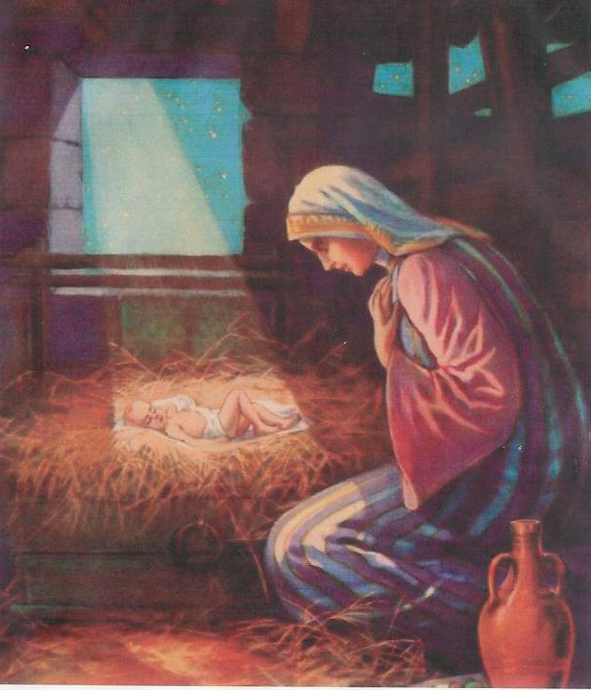
The Nativity
Matthew
1:25
Luke
2:1-7

Slide 38
The Baptism of Jesus Matt.3:1-17, Mark 1:9-11, Luke 3:1-22, John 1:19-34

Slide 39
Calling of Disciples - Apostles Matt. 4:18-22, 10:2-4 Mark 1:14-20, Luke 6:12-16, John 1:35-51
Andrew
Simon Peter

Slide 40
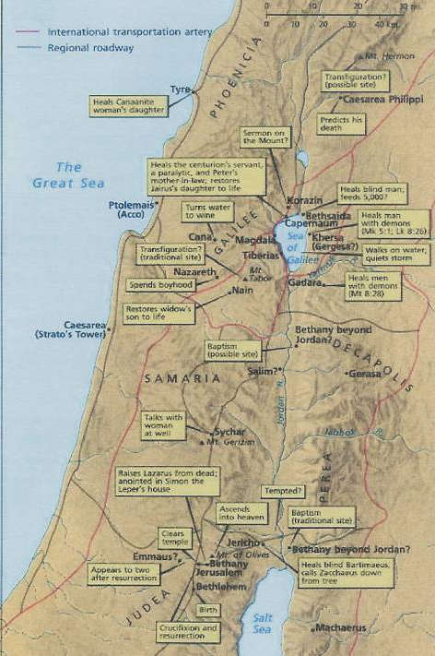
Jesus’ Ministry

Slide 41
Miracles of Jesus

Slide 42
Jesus the Teacher

Slide 43
Parables
The Sower
The Prodigal Son
The Good Samaritan

Slide 44
Lazarus Raised From The Grave
John 11: 38-53

Slide 45
Passion Story
Last
Week
In
Jerusalem

Slide 46
Entry Into Jerusalem

Slide 47
The Upper Room

Slide 48
The Crucifixion

Slide 49
The Resurrection

Slide 50
Confirmation
The Apostles
And The
Early Church
~
The Book of Acts

Slide 51
Pentecost The Birth of the Church Acts 2:1-13
The Feast
Of The
Weeks
Shavuot
Moses Received
The
Ten Commandments
49 Days
After The
Resurrection

Slide 52
The Struggle
Judaism
(Jerusalem Church – James)
Vs.
New Religion
(Paul)

Slide 53
Saul’s Conversion to Paul Acts 9:1-22
Damascus 37-40 AD

Slide 54
Paul
The Great Missionary

Slide 55
Paul’s First Journey 45-47 AD
Paul
Barnabas
Mark

Slide 56
Paul’s Second Journey 51-53 AD
Paul
Silas
Timothy
(Lystra)

Slide 57
Paul’s Third Journey Rhodes – Patara - Tyre – Ptolemais – Caesarea - Jerusalem
Macedonia
Galatia
Phrygia

Slide 58
Rome House Arrest, 61–63 AD

Slide 59
Paul’s Epistles

Slide 60
Paul’s Epistles
Romans
1 & 2 Corinthians
Galatians
Ephesians
Philippians
Colossians
1 & 2 Thessalonians
1 & 2 Timothy
Titus
Philemon

Slide 61
General Epistles
Hebrews (?)
James
45-50 AD (Brother of Jesus)
1st Peter
63 AD (Apostle Peter)
2nd Peter
66 AD (Apostle Peter)
1st, 2nd, 3rd John
90 AD (Writer of Gospel of John)
Jude
70-80 AD (Brother of Jesus)

Slide 62
Revelations
90s AD
John
Written to Give Strength
And
Hope
To The Persecuted Christians

Slide 63
The Catechism

Slide 64
Catechism
A
Manual
Of
Doctrine

Slide 65
The Small Catechism
The Ten Commandments
The Apostles’ Creed
The Lord’s Prayer
The Sacrament of Baptism
Confession
The Sacrament of the Altar
Morning and Evening Blessing
Blessings at Meals

Slide 66
The Ten Commandments
First Three Commandments
~~~~
Relationship with God

Slide 67
The Ten Commandments
4th - 10th
Commandments
~~~~
Social Commandments
Relationships and Actions with Others

Slide 68
LAW & GOSPEL
Law ???

Slide 69
LAW & GOSPEL
Condemnation

Slide 70
LAW & GOSPEL
Gospel ???

Slide 71
LAW & GOSPEL
LOVE

Slide 72
Creed
A Religious statement of belief.
~~~~~
From Latin “Credo”
I believe.

Slide 73
Christian Creeds
Apostles’ Creed
Nicene Creed
Athanasian Creed

Slide 74
The
Trinity

Slide 75
The Trinity
How
God
Reveals
Himself
~~~
Father, Son, Holy Spirit.

Slide 76
The
Lord’s
Prayer

Slide 77
Confirmation #10
The
Sacraments
And Doctrines

Slide 78
Lutheran Sacraments
Baptism
Holy Communion

Slide 79
Other Major Lutheran Doctrines
Justification by Faith vs. Works
(Romans 1: 16-17)
Law & Gospel
(Romans 8:1-2)
Grace
(Romans 3:23-24)
Original Sin
Priesthood of all Believers

